Slide 2
Entrepreneurship in Data Science

Slide 3

Suitable background music for coffee shops
Supervisor: Prof. Trần Hoàng Hải
Student: Lê Hoàng Long - 20232099M

Slide 4

Agenda
The chosen industries/sectors
The business idea
The problem to be solved
The target and market potential

Slide 5

The chosen industries/sectors
Coffee shops use music to create a welcoming atmosphere, influence customer behavior, enhance the experience, and boost satisfaction, shaping the ambiance and adding to their unique character.

Slide 6
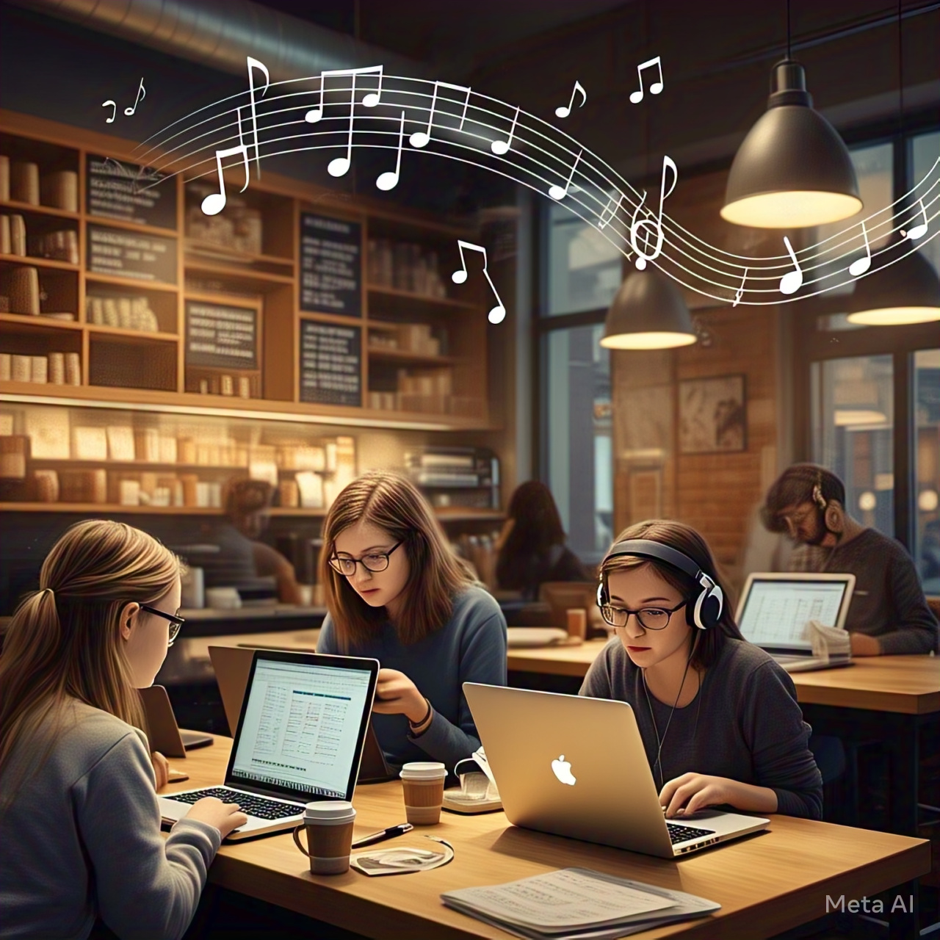
The chosen industries/sectors
Young people today enjoy spending time in coffee shops.
A popular trend among the youth is: "The lower your income, the more often you visit coffee shops."

Slide 7
The chosen industries/sectors
Those in the low-income group (earning between 5-10 million VND per month) visit coffee shops about 1-3 times per week, accounting for approximately 38%.
Due to limited space in dormitories and motel rooms, many people visit cafes multiple times a week to study and work.

Slide 8
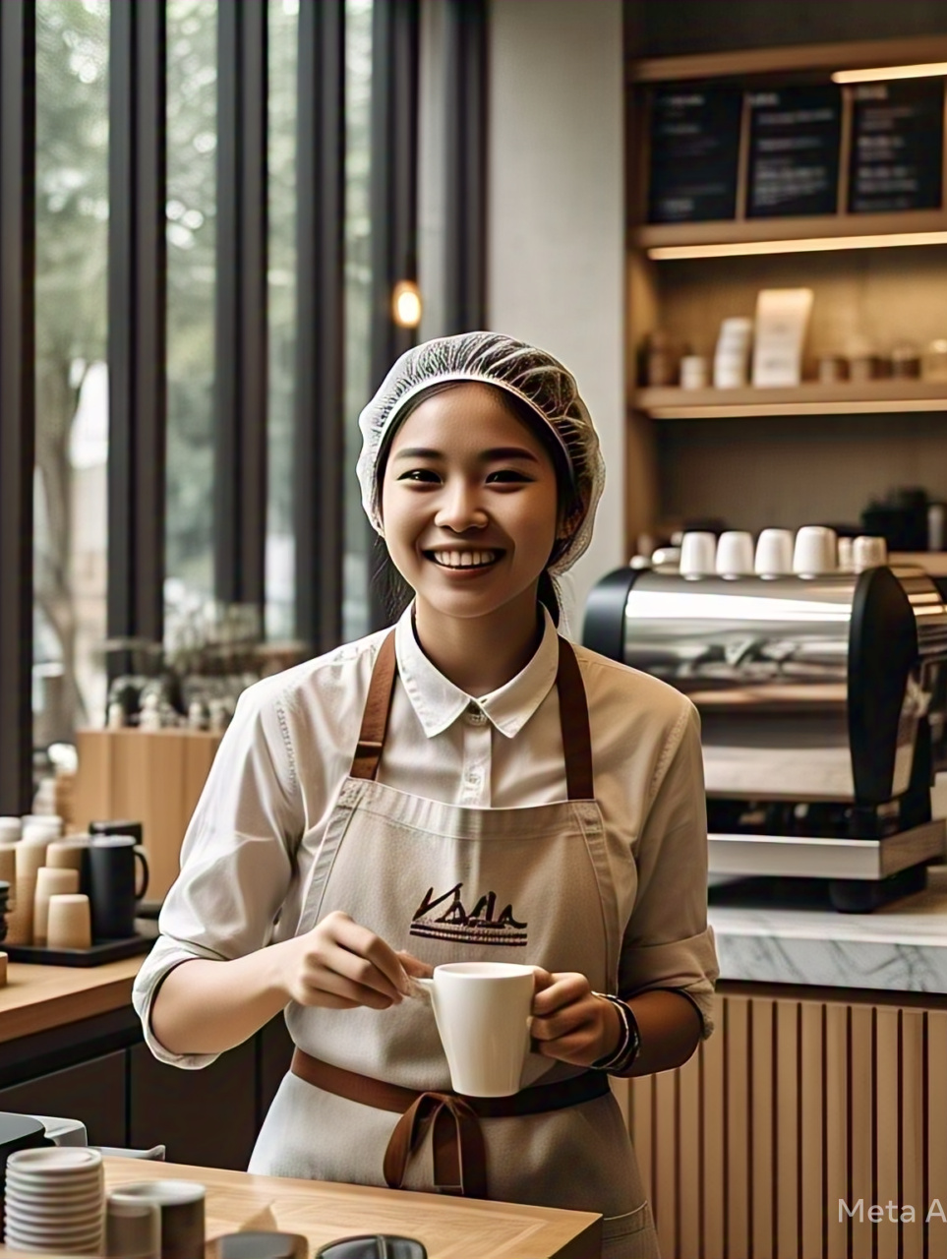
The chosen industries/sectors
Going to a coffee shop isn't just about the coffee. It’s more than just enjoying a drink.
It’s a productive study space, a hub for teamwork, a peaceful spot to read, and a place to unwind after the stress of work or study.
The atmosphere of a café plays a crucial role in choosing where to go.

Slide 9
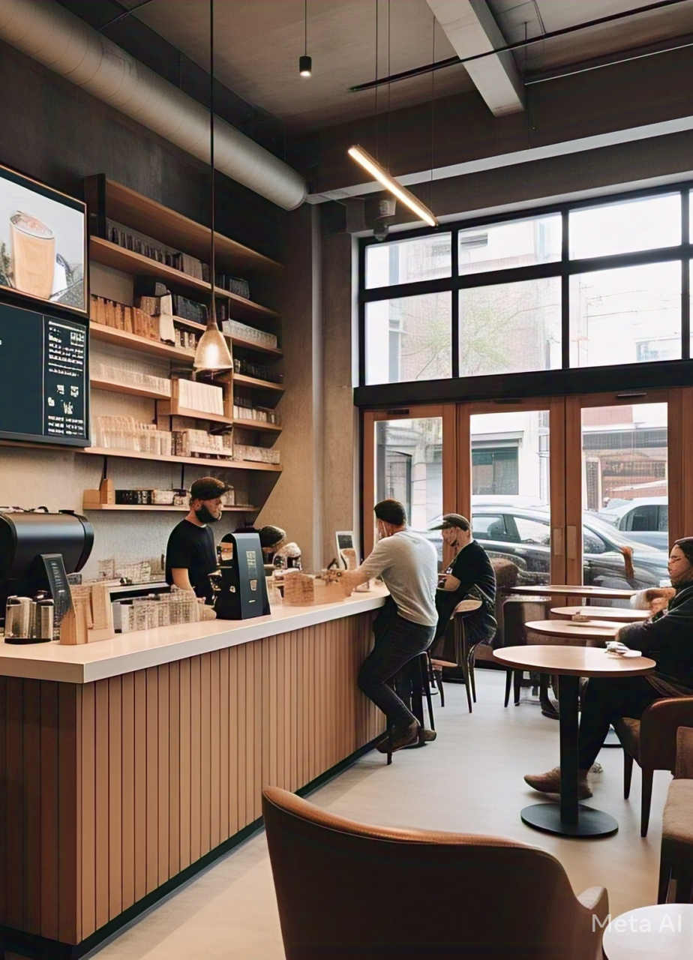
The business idea
Developing a viable business model
Coffee houses aim to boost their profits, and music can play a significant role in attracting customers and enhancing their experience.
Choosing the right background music is essential to make customers feel relaxed and comfortable.
However, hiring a barista skilled in selecting music tailored to clients' preferences can be expensive.
For coffee shop chains, artificial intelligence offers a cost-effective alternative, ensuring a consistent and enjoyable experience across all locations.

Slide 10
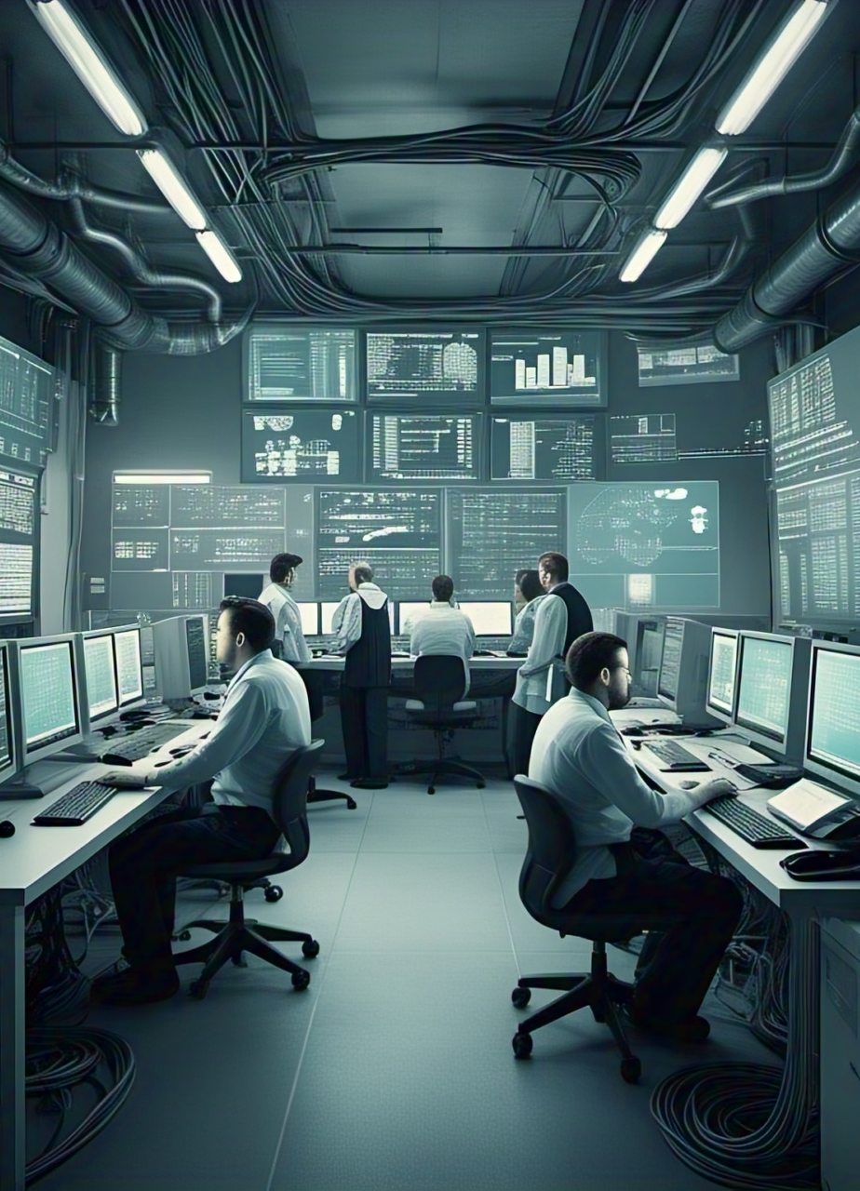
The business idea
Understanding the industry
Our expertise lies in Computer Vision and Big Data Analysis.
We develop tailored artificial intelligence models to address the specific needs of the coffee shop industry.

Slide 11
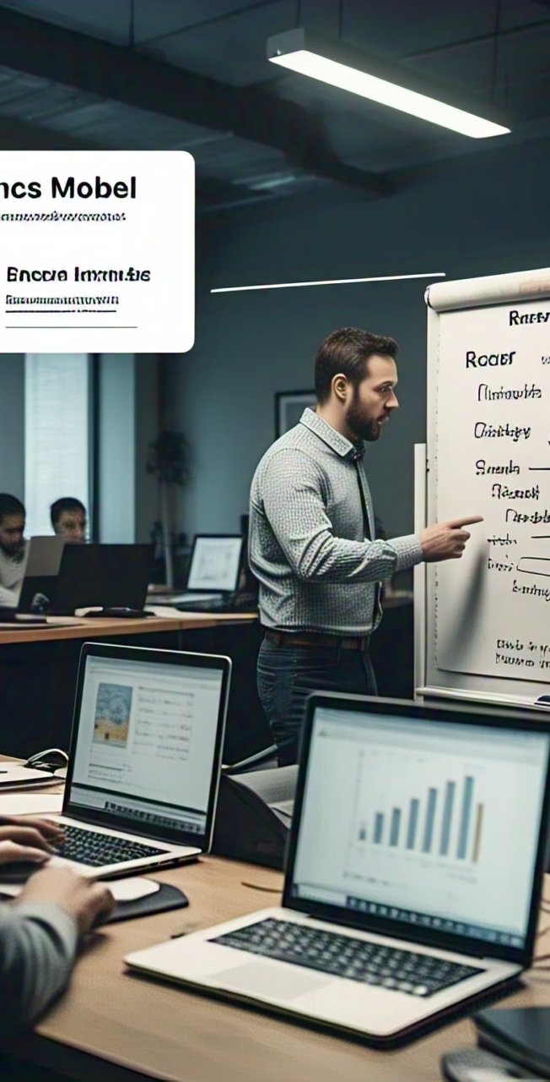
The business idea
Revenue Model:
Subscription Plans: Tiered pricing based on features and user capacity, ensuring accessibility for businesses of all sizes.
Professional Services: Offering consulting and training to help companies seamlessly integrate AI into their workflows.

Slide 12

The problem to be solved
Personalized Music Recommendations:
Identify customers' identities to match music with their age, preferences, and styles.
Emotion Detection and Analysis:
Monitor customers' emotions during their visit to curate music that aligns with their mood.
Track client interactions and gather emotional responses to each song.
Recommend suitable songs based on collected insights.

Slide 13

The target and market potential
Targets
Coffee shops with budgets dedicated to enhancing customer satisfaction.
Market potential
There are hundreds of coffee shop in Hanoi
Customer preferences for coffee shops are influenced more by ambiance and experience than by drink taste.
While updating decor to meet customer preferences daily is challenging, adjusting the music is a more flexible and effective solution.

Slide 14
THANK YOU !

